Slide 1
Perfect Hashing
Topic 6 Discussion 1
Ryan Coon

Slide 2
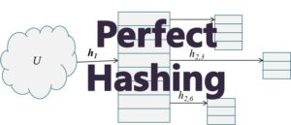
What is perfect Hashing?
Perfect hashing is used when keys stored in the hash table are expected to be static. In this case perfect hashing guarantees excellent average as well as worst-case performance.
Also known as FKS proposed by Fredman, Komlos, and Szemeredi in 1984.

Slide 3
What is perfect Hashing?
Examples:
Dictionary – because most of the time you just need to read from a dictionary
Data storage on a CD ROM
Set of reserved words in a programming language

Slide 4
What is perfect Hashing?
Perfect hashing is implemented using two hash tables, one at each level. Each of the table uses universal hashing. The first level is the same a hashing with chaining such that n elements is hashed into m slots in the hash table. This is done using a has function selected from a universal family of hash functions.
The second level of uses a second hash table (instead of a linked list used in chaining). Elements that hash to the same slot j in the first hash table are stored in a second hash table. This second hash table is known as secondary hash table . The hash function h_{j} is carefully chosen such that there are no collision in the secondary table.
To ensure there are no collisions in the secondary hash table S_{j}, we need to make the size m_{j} of the secondary table equal to the square of the number of keys hashing into slot j in the first table. That is:
m_{j} = n_{j}²
The hash functions for the primary hash table is carefully chosen so that we limit the expected total amount of space used to be O(n).

Slide 5
What is perfect Hashing?
The first level hash function is chosen from the universal hash family ℋ pm where p is a prime number larger than any key value. So the keys that hash into slot j of the first hash table are placed into a secondary hash table S_{j} using the hash function h_{j} which is chosen from another family of hash functions ℋ _{p,mj}. The size of the secondary hash table is m_{j}.
The objective is to achieve a situation where there are no collisions in the secondary hash table. At least no expected collisions.

Slide 6
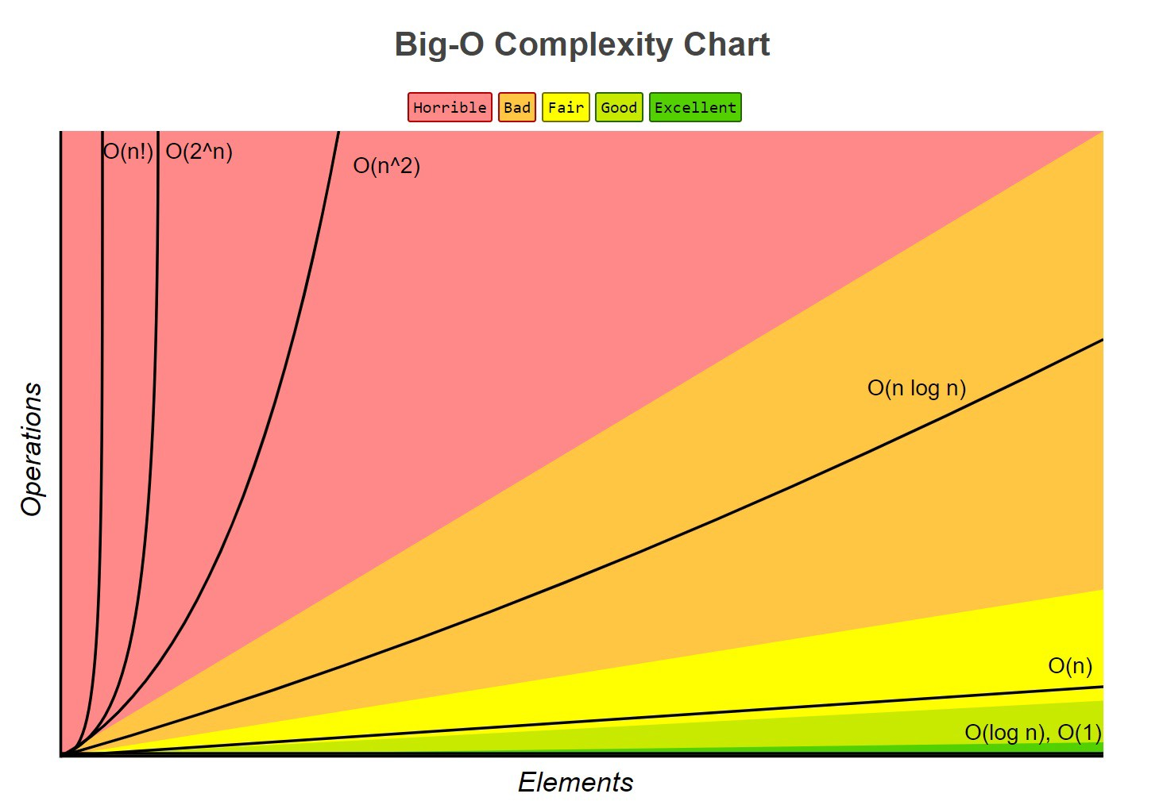
Big O Analysis
This hashing technique is called perfect hashing because it takes constant time, O(1) to search for an item in the table. O(n) in worst case space.

